Slide 1
Regression Testing
Regression testing is the re-execution of some subset of tests that have already been conducted to ensure that changes have not propagated unintended side effects.
Whenever software is corrected, some aspect of the software configuration (the program, its documentation, or the data that support it) is changed.
– Regression testing helps to ensure that changes (due to testing or for other reasons) do not introduce unintended behavior or additional errors.

Slide 2
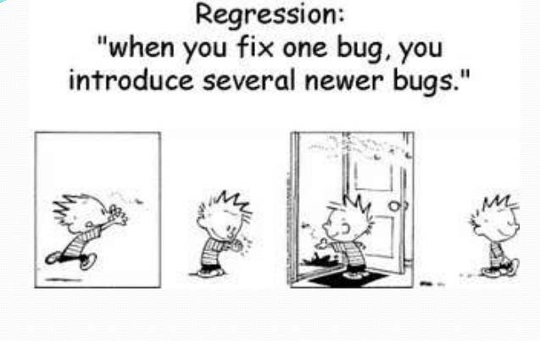

Slide 3
When to do it
Regression Testing is required when there is a :
Change in requirements and code is modified according to the requirement
New feature is added to the software
Defect fixing
Performance issue fix

Slide 4
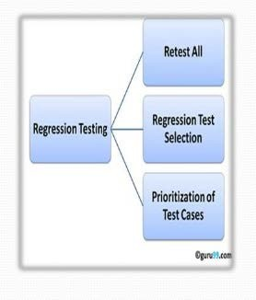
What’s the strategy?
Software maintenance is an activity which
includes
enhancements, error corrections, optimization and deletion of existing features.
These modifications may cause the system to work incorrectly.
Therefore, Regression Testing becomes necessary.
Regression Testing can be carried out using following techniques:

Slide 5
What’s the strategy? (Cont…)
Retest all - This is one of the methods for regression testing in which all the tests in the existing test bucket or suite should be re-executed.
This is very expensive as it requires huge time and resources.

Slide 6
What’s the strategy? (Cont…)
Regression Test Selection
Instead of re-executing the entire test suite, it is better to select part of test suites.
Focus on software functions that are likely to be affected by the change.
Focus on the software components that have been changed.

Slide 7
Prioritization of Test Cases
Prioritize the test cases depending on business impact, critical & frequently used functionalities.
Selection of test cases based on priority will greatly reduce the regression test suite.

Slide 8
Selecting Regression Tests:
Requires knowledge about the system and how it affects by the existing functionalities.
Tests are selected based on the area of frequent defects.
Tests are selected to include the area, which has undergone code changes many a times.
Tests are selected based on the criticality of the features.
Test cases of Functionalities which has undergone more and recent changes.
All Integration Test Cases.
All Complex Test Cases.

Slide 9
Software Regression Process
Software Regression Process:
Step #1: Software Change Analysis
Understand and analyze various software changes.
Step #2: Software Change Impact Analysis
Understand and analyze software change impacts
Step #3: Define Regression Test Strategy and Criteria
Step #4: Define, select, and reuse test cases to form a regression test suite Step #5: Perform re-testing at the different levels.
re-testing at the unit level
re-testing at integration level
re-testing at the function level
re-testing at the system level
Step #6: Report and analyze regression test results

Slide 10
Software Regression Process
Software Change Analysis
Software Change Impact Analysis
Define Regression Testing Strategy
Build Regression Test Suite
Run Regression Tests at different levels
Report Retest Results

Slide 11
Regression Testing ensure that the new changes hasn't affected other parts of the software.
Re-Testing means testing the functionality or bug again to ensure the code is fixed.
If it is not fixed, defect needs to be re-opened. If fixed, defect is closed.

Slide 12
Challenges for regression testing:
With successive regression runs, test suites become fairly large.
Due to time and budget constraints, the entire regression test suite cannot be executed.
Minimizing test suite while achieving maximum test coverage remains a challenge.

Slide 13
Conclusion
Regression Testing is the verification method.
It verify that the bugs are fixed and the newly added features hasn't affect other parts of the software.
Regression testing is very important that when there is continuous improvements added in the application.

